Slide 1

Individual Project 2-DATS6103
Ujjwal Oli
11/10/2020

Slide 2
Steps involved
Research data from world bank
1
Import packages
2
Import data
3
Filtering and cleaning data
4
Arranging data frames and visualization
5
Analysis and conclusion
6

Slide 3
Motto of the project
Compare
Compare the military data to that country’s GDP
Compare
Compare the overall military spending of the all 10 countries in absolute and percentages
Compare
Compare the per person military spending to the per person GDP in absolute and percentages
Single out
Single out the fastest growing countries in military spending in absolute and percentage

Slide 4
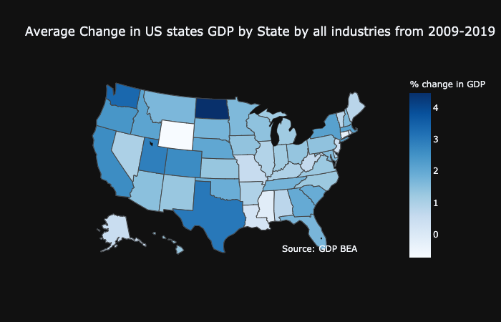

Slide 5
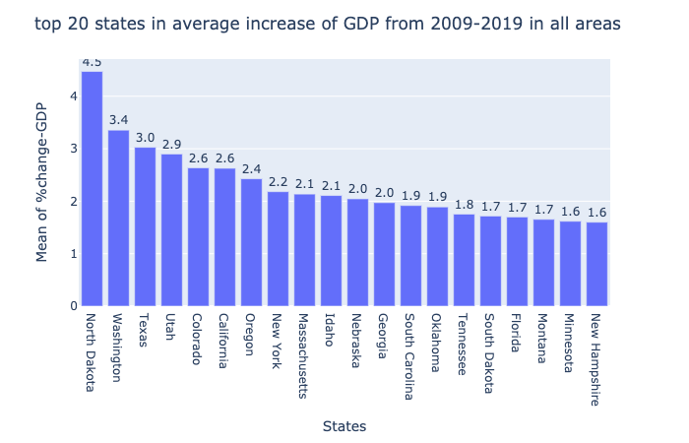

Slide 6
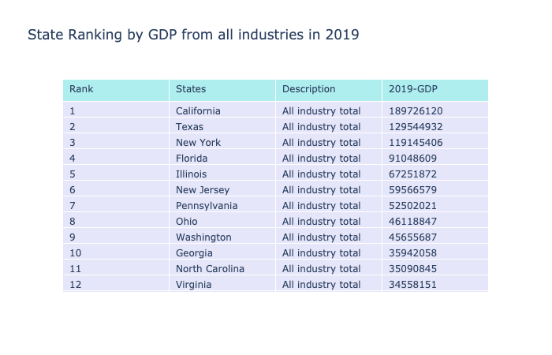

Slide 7
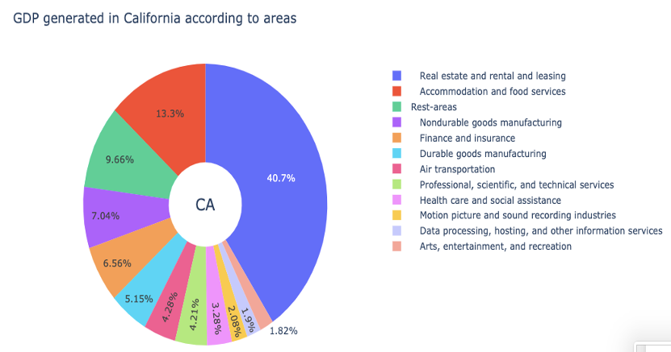

Slide 8
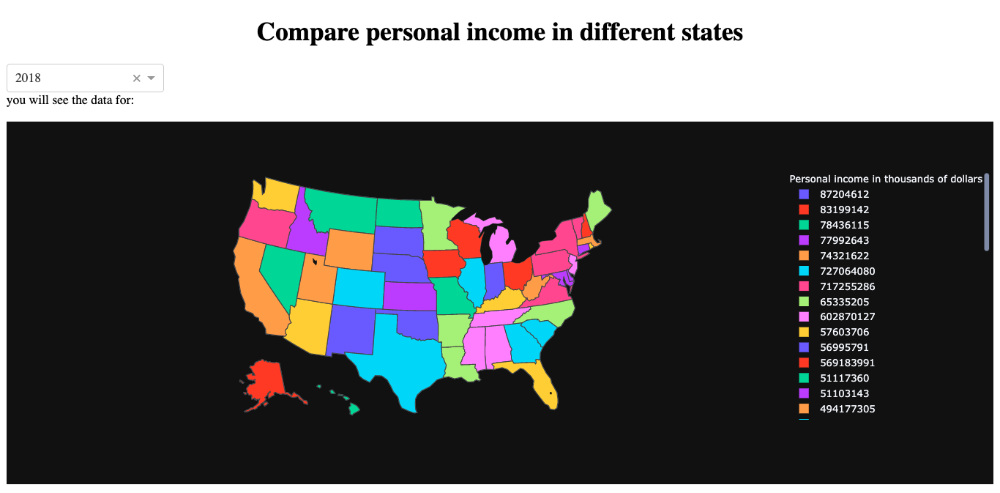

Slide 9
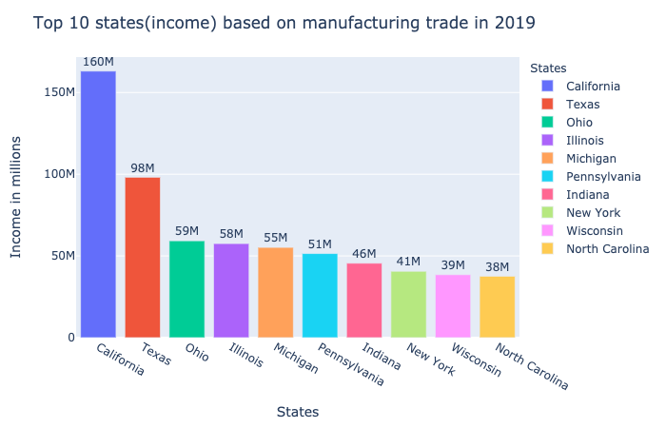
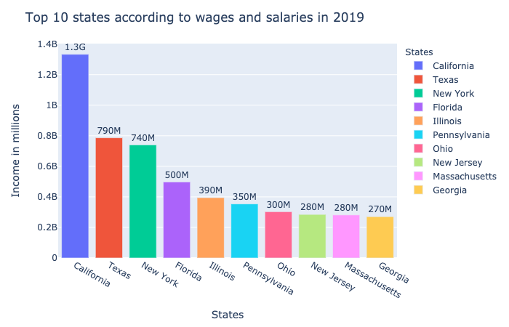

Slide 10
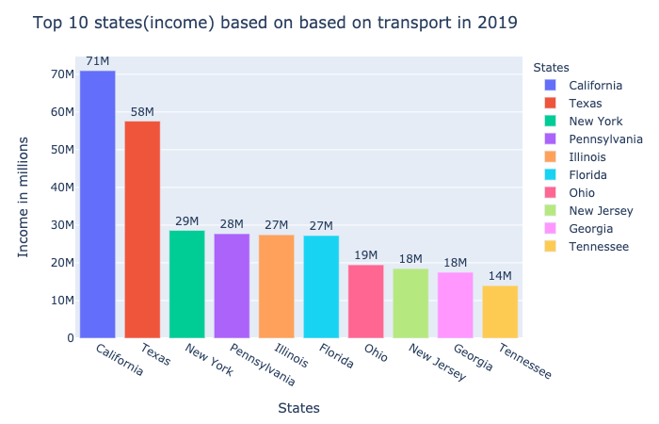
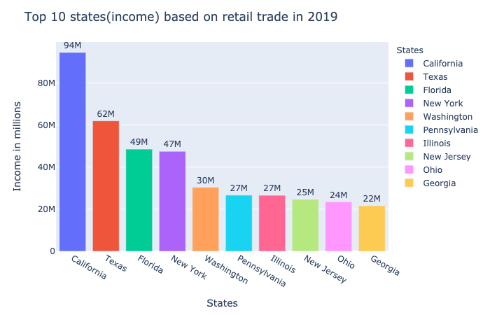

Slide 11
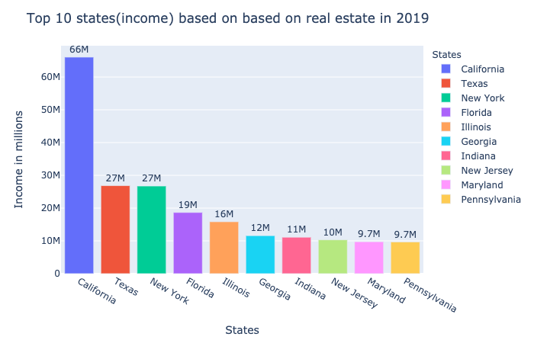
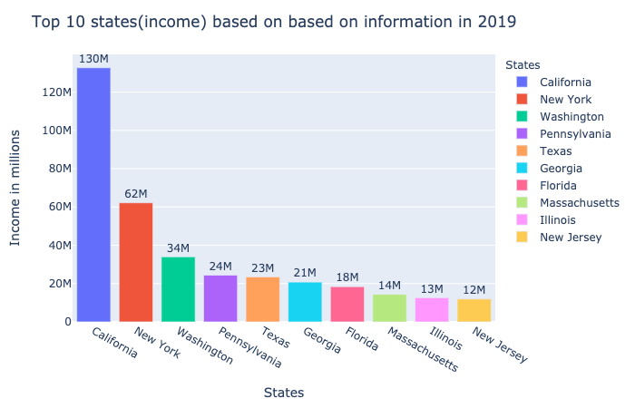

Slide 12
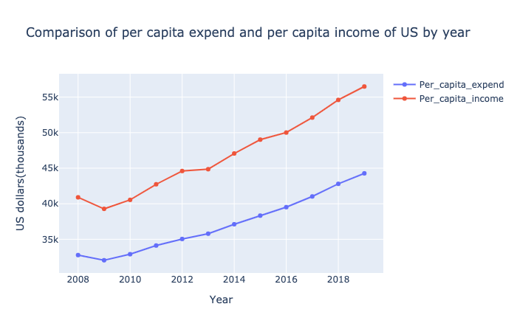

Slide 13
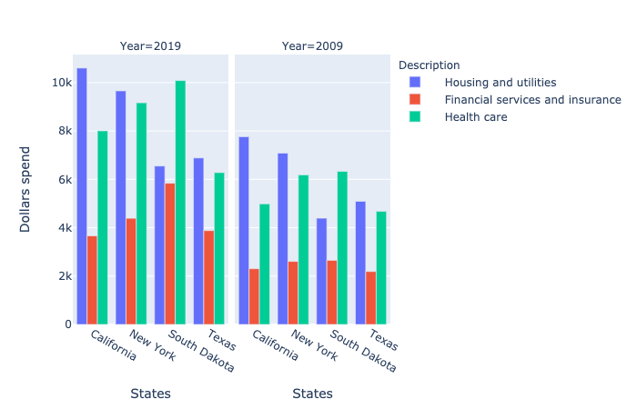
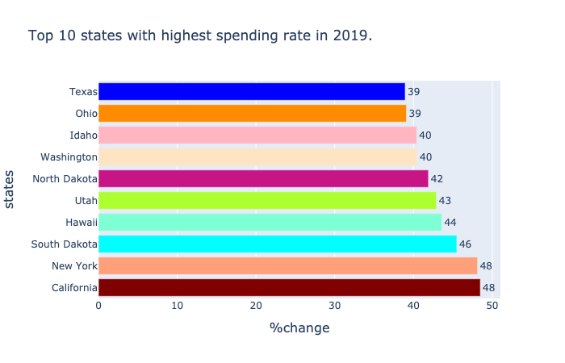

Slide 14
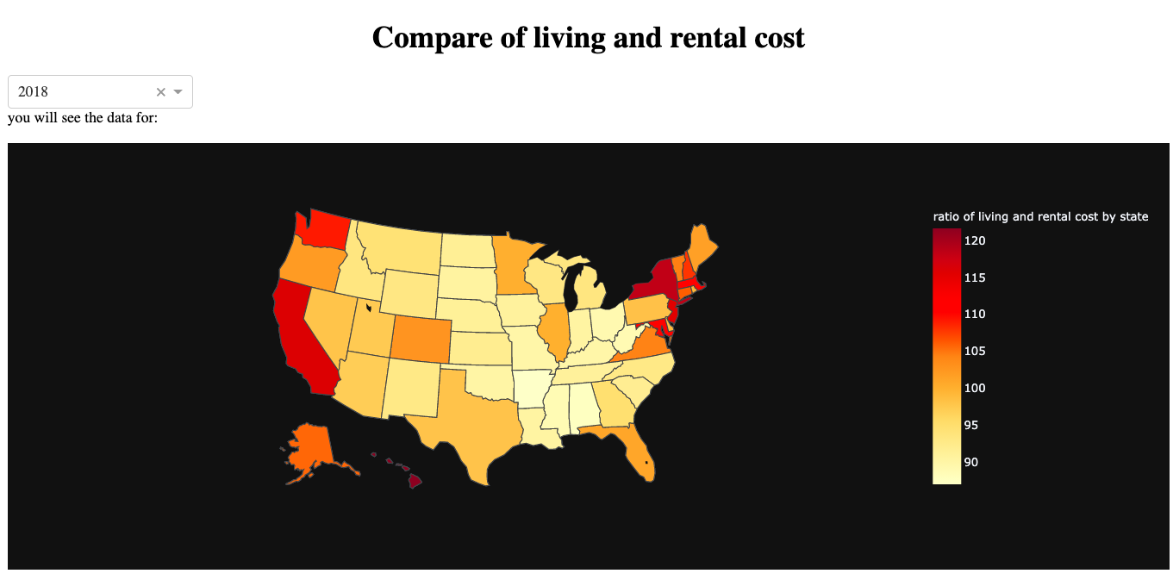

Slide 15
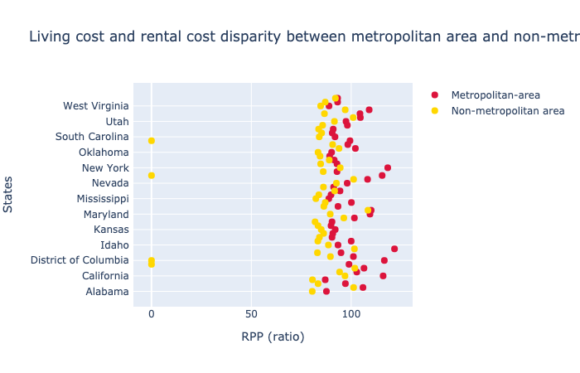

Slide 16
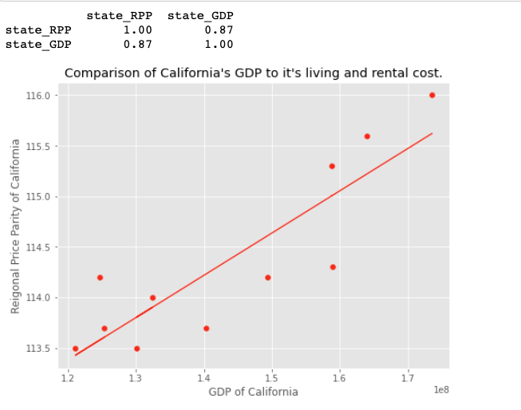

Slide 17
